Slide 1



JSON-to-Tabular-Converter: Python Project Introduction
The JSON-to-Tabular-Converter is a Python project designed to streamline data processing. It transforms complex JSON data into easy-to-use tabular formats, simplifying data analysis by flattening nested JSON structures. The tool features a user-friendly GUI and exports results as CSV for broad compatibility.
Notes:
1

Slide 2
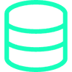



Purpose of JSON-to-Tabular-Converter
Address Data Complexity
Enable Quick Transformation
Tackles the inherent challenges of analyzing deeply nested JSON data structures, making them accessible.
Facilitates rapid conversion to tabular formats like CSV and Pandas DataFrames for immediate use.
Facilitate Analysis
Bridge Tooling Gaps
Streamlines exploratory data analysis and reporting, turning raw data into actionable insights.
Connects JSON data from APIs with traditional spreadsheet tools, enhancing workflow efficiency.
Notes:
2

Slide 3
Main Features Overview
User-Friendly Interface
Seamless Export
Graphical User Interface (GUI) for intuitive file selection and conversion.
Exports clean, flat CSV files, ready for immediate analysis.
Simplifies the process for users of all technical levels.
Ensures broad compatibility with various data analysis tools.
Advanced JSON Handling
Efficient Processing
Intelligently flattens deeply nested JSON structures.
Supports batch processing for converting multiple JSON files simultaneously.
Preserves data integrity while optimizing for tabular display.
Designed for performance, even with large datasets.
Notes:
3

Slide 4
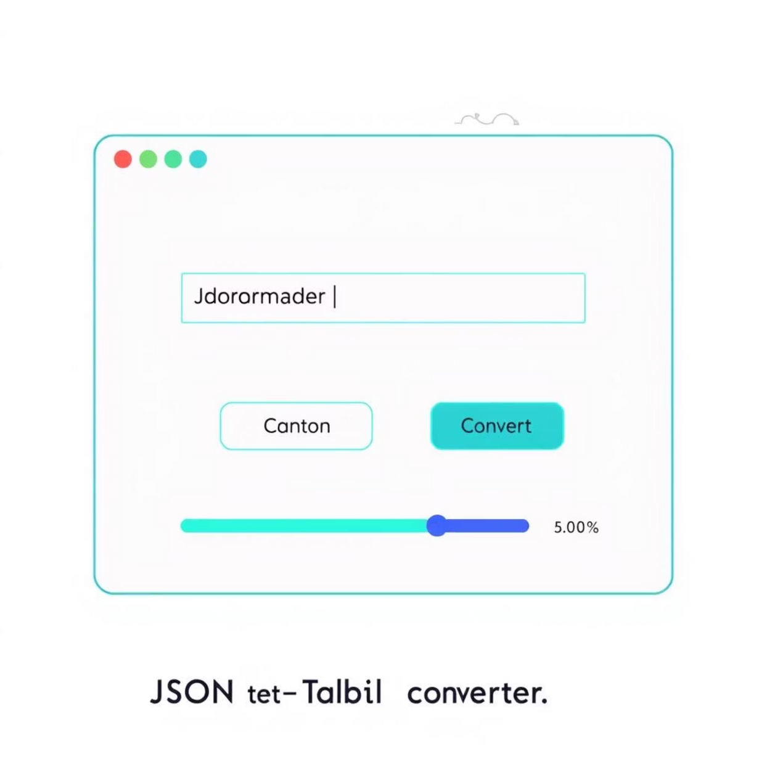
GUI Support: User Interaction Made Simple
Intuitive Design
The GUI provides an easy-to-navigate window for loading JSON files and initiating conversions with a single click.
Visual Feedback
Users receive real-time progress updates, ensuring transparency throughout the conversion process.
Customization Options
Options to adjust flattening depth and specify output locations give users precise control over their data transformation.
Notes:
4

Slide 5
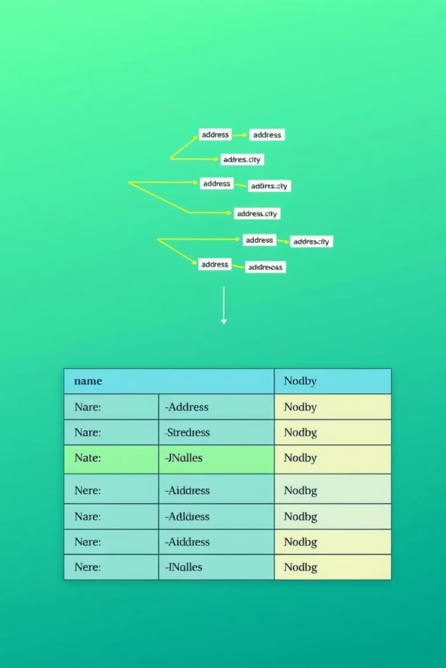
Nested JSON Conversion Explained
The converter intelligently flattens complex JSON structures by recursively transforming nested dictionaries and arrays into distinct columns. It employs a clear key path naming convention (e.g., "location.city") to maintain data context and readability. This process leverages powerful Python libraries like json and pandas.json_normalize.
Notes:
5

Slide 6
CSV Export Functionality
The processed data is converted into a standard CSV format, ensuring seamless integration with popular analysis tools such as Microsoft Excel, Google Sheets, and various Business Intelligence (BI) platforms. The converter also features efficient streaming support to handle large files without compromising performance.
name,address.street,address.city,products.0.id,products.0.nameJohn Doe,123 Main St,Springfield,P001,LaptopJane Smith,456 Oak Ave,Shelbyville,P002,Mouse
The CSV output is clean and readily consumable, eliminating the need for manual data cleaning or restructuring.
Notes:
6

Slide 7




Key Technologies Used
Python 3.8+
Pandas
The core language for scripting, data processing, and orchestrating all functionalities.
Utilized for efficient JSON normalization, DataFrame manipulation, and robust data handling.
Tkinter
CustomTkinter
The standard Python library for creating the fundamental graphical user interface (GUI).
An extension to Tkinter, providing modern UI components and a visually appealing design for the GUI.
Notes:
7

Slide 8
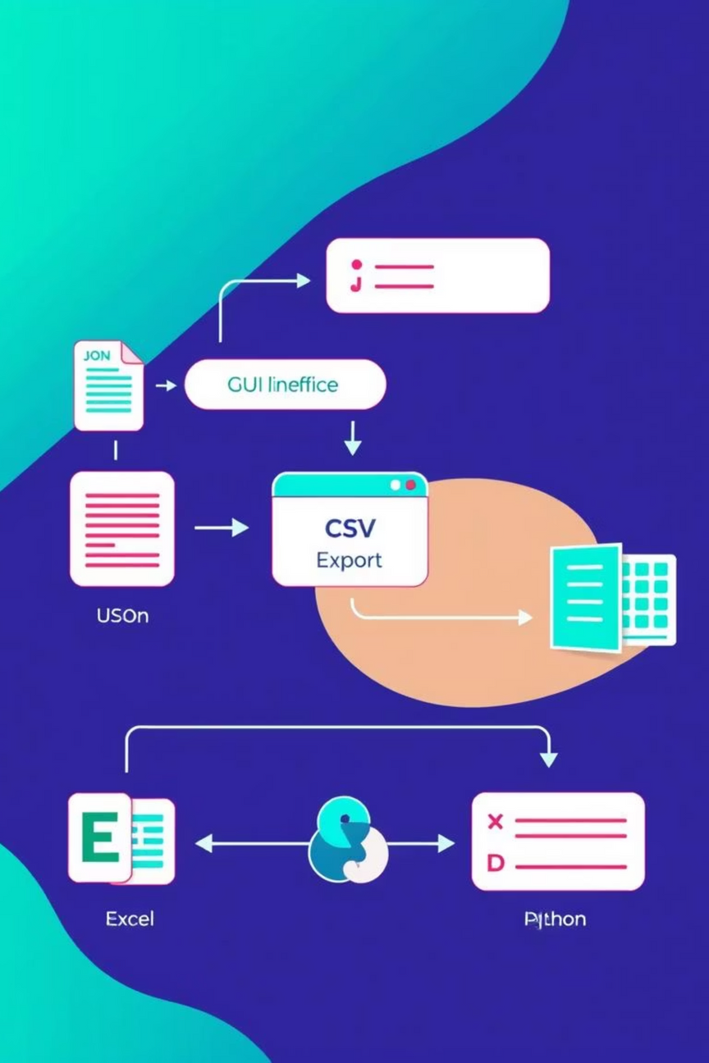




Example Workflow: From JSON to Analysis
Step 1: Load JSON
User selects and loads a JSON file using the intuitive GUI.
Step 2: Process Data
The tool automatically parses and flattens nested JSON data structures.
Step 3: Export CSV
User exports the processed, flattened data into a clean CSV file.
Step 4: Analyze
The CSV is imported into analytical tools like Excel, Python (Pandas), or BI dashboards for insights.
Notes:
8

Slide 9
Practical Benefits for Data Analysis
1
Significant Time Savings
Automates manual JSON parsing and cleaning, drastically reducing preparation time.
Empowers Non-Programmers
2
Enables users without coding expertise to easily convert and manage JSON data.
3
Enhanced Data Accessibility
Improves readability and accessibility of complex data, making it usable across various departments.
4
Supports Data-Driven Decisions
Provides clean, structured datasets essential for accurate reporting and informed decision-making.
5
Fosters Broader Adoption
Encourages wider use of JSON data in data science, business intelligence, and operational workflows.
Notes:
9

